Slide 1
UNIVERSITY MANAGEMENT SYSTEM
Campus Operations,
Unified in One Desktop App
A C#/.NET WinForms platform that lets one administrator manage students, instructors, courses, enrollment, scheduling, and reporting — without juggling spreadsheets.
Students
Instructors
Courses
Enrollment
Scheduling
Reports
2026 | Project Report

Slide 2




PROJECT TEAM
Prepared By
The team behind the University Management System 2026 build.
Bai Ran-Hao
Chen Zhi-Kai
Gao Ming-Jie
Kang Rui-Le
Student ID
Student ID
Student ID
Student ID
25101318
25101309
25101305
25101329
02

Slide 3
AGENDA
What We'll Cover
Six areas: the problem, the solution, how it's built, what it does, and what's next.
01
02
03
The Problem
The Solution
Architecture
Why manual student record-keeping breaks down
A single desktop system for the whole campus workflow
Tech stack, data model, and role-based access
04
05
06
Core Modules
Reporting
Roadmap
Students, instructors, courses, enrollment, scheduling
Live analytics and visual breakdowns for decisions
Current limits and what comes next
03

Slide 4



01 — THE PROBLEM
Why Universities Outgrow Spreadsheets
Student records, courses, and schedules scale faster than manual tracking can handle.
Scattered Records
Slow Manual Work
No Real-Time Insight
Student, course, and grade data living in separate spreadsheets with no single source of truth.
Adding a student, enrolling them, and checking for schedule clashes all done by hand, one row at a time.
Department heads can't see enrollment totals or budget breakdowns without building a new report each time.
04

Slide 5
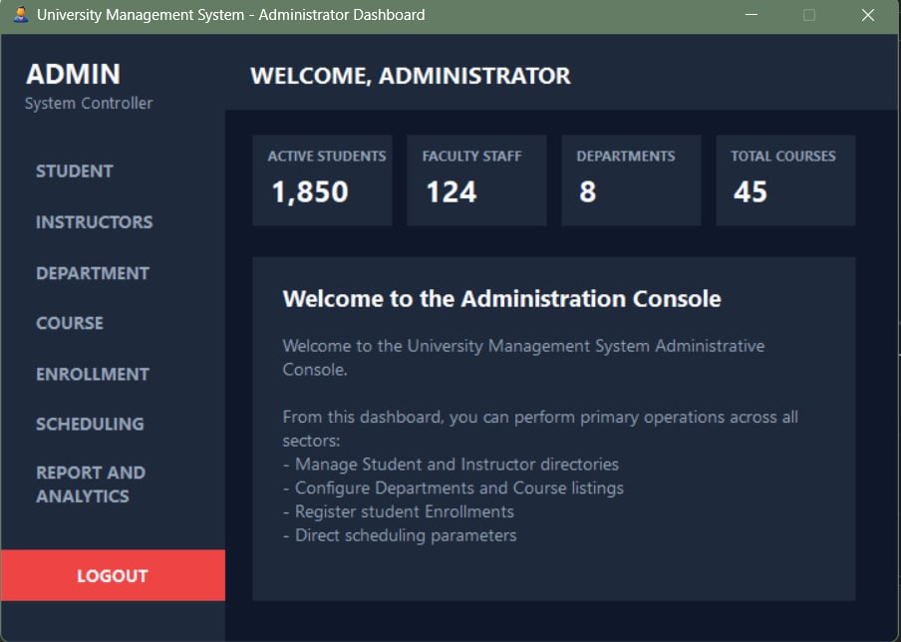

02 — THE SOLUTION
One System, Every Campus Workflow
A single WinForms desktop application replaces the spreadsheet patchwork with one connected database.
Centralized data: students, instructors, courses, and grades in one SQL-backed database.
Role-based logins separate what Admins, Instructors, and Students can see and do.
Built-in scheduling conflict checks catch overlapping class times before they happen.
One-click reports and charts turn raw tables into decisions instantly.
The Administrator Dashboard — live counts at a glance
05

Slide 6





03 — ARCHITECTURE
Built on a Familiar, Proven Stack
Standard Microsoft technologies chosen for stability inside a Windows-based campus IT environment.
C# WinForms
Entity Framework 5
SQL Server
Role-Based Login
.NET Framework 4.7.2 desktop UI
ORM mapping objects to SQL tables
Relational database via SQL Express
Admin, Instructor, Student accounts
WinForms UI
(Forms & Controls)
Entity Framework
(Data Access Layer)
SQL Server
(University DB)
Three-tier design: the UI never talks to SQL directly — Entity Framework mediates every read and write.
06

Slide 7
03 — ARCHITECTURE
The Data Model
Ten related tables capture every entity in a university — and how they connect to each other.
department
student
instructor
course
section
name, building, budget
ID, name, dept, total credits
ID, name, dept, salary
course_id, title, dept, credits
course offering per semester/year
take
classroom
time_slot
advisor
user
enrollment record + grade
building, room, capacity
day, start/end time
links student ↔ instructor
login + role
Relationships: a student belongs to a department, takes sections of a course, and is paired with an advisor (instructor). Each section is tied to a classroom and a time slot.
07

Slide 8



03 — ARCHITECTURE
One Login, Three Experiences
Every account has a role. The system routes each person to the screen built for their job.
Full Control
Teaching View
Personal View
Administrator
Instructor
Student
Full access: manage students, instructors, departments, courses, enrollment, scheduling, and reports.
Views their own sections, rosters, and schedules tied to the courses they teach.
Views personal enrollment, grades, and total credits — read-focused access.
08

Slide 9
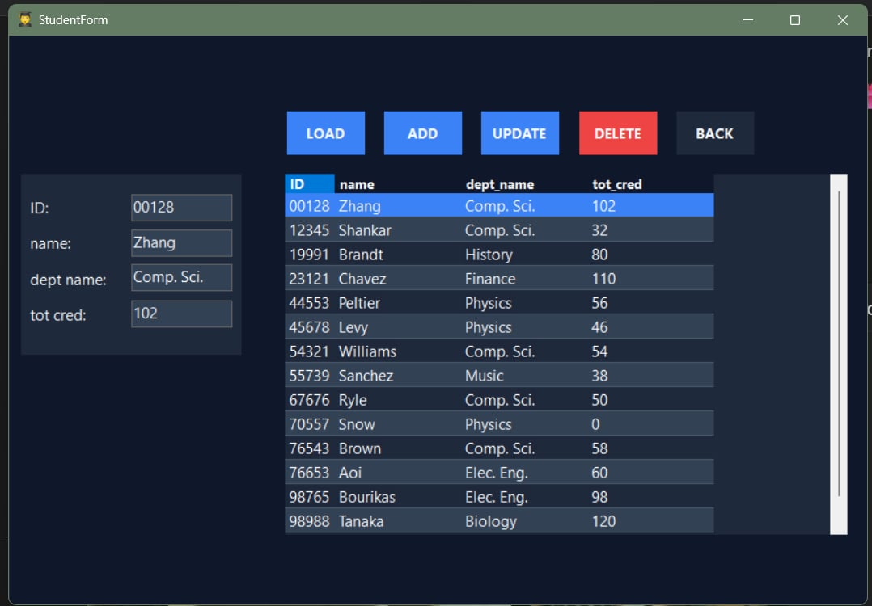




04 — CORE MODULES
Student Records Module
Add, search, update, and remove student records — each one tied to a department and a running credit total.
Load & Browse
Pull the full roster into a sortable grid with one click.
Add
Register a new student with ID, name, department, and credits.
Update
Edit any field, such as department transfer or credit total.
Delete
Remove a record when a student withdraws or graduates.
Student Form — roster, detail fields, and CRUD actions
09

Slide 10
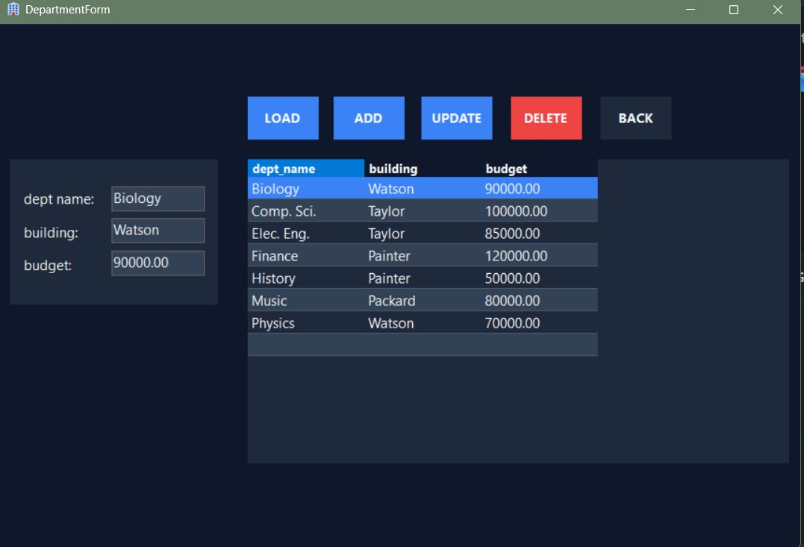
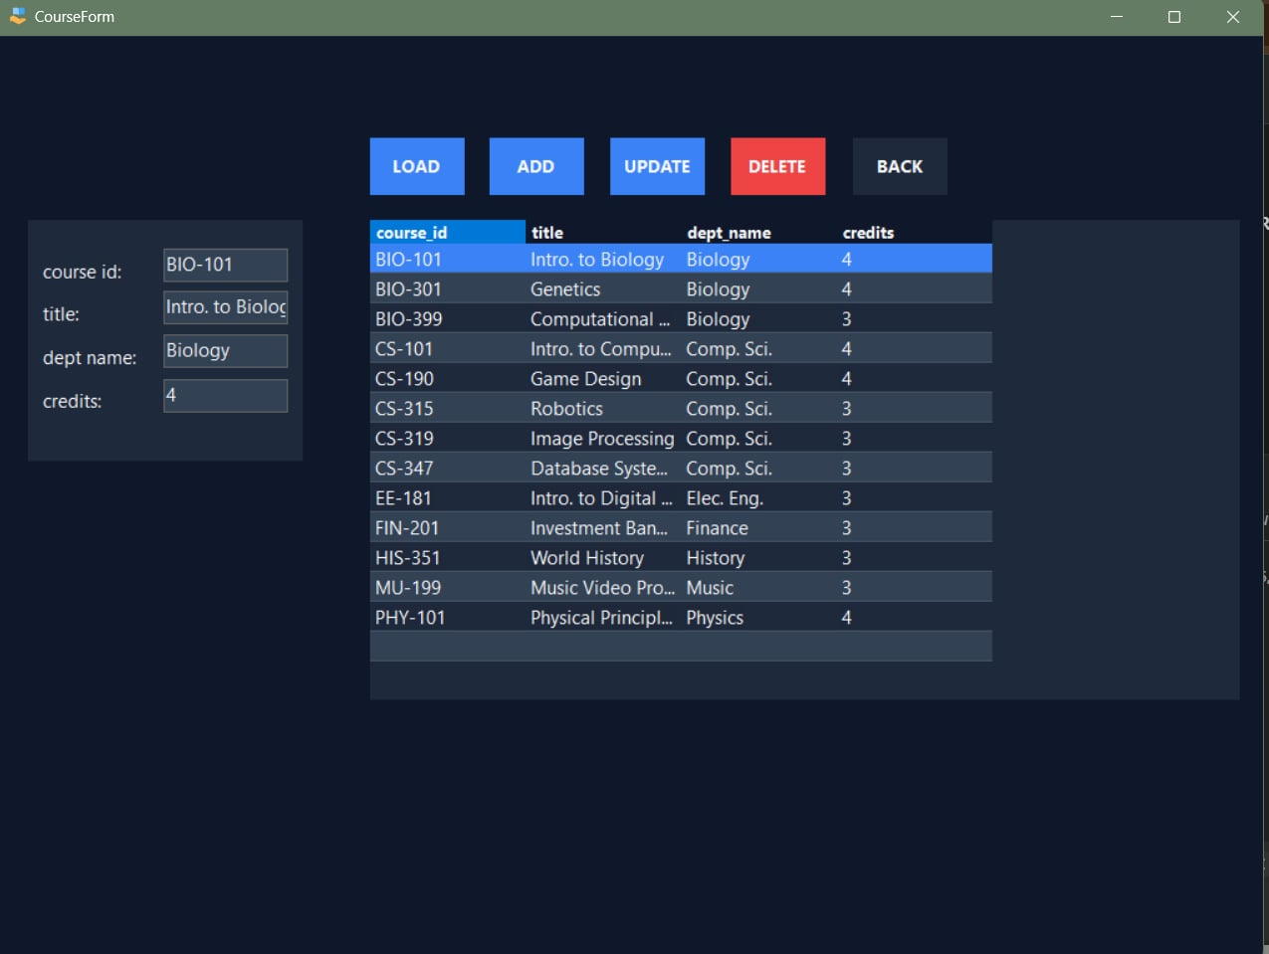
04 — CORE MODULES
Course & Department Catalog
Departments own a building and a budget. Courses belong to a department and carry a credit value.
Department Form — name, building, budget
Course Form — ID, title, department, credits
Every course record links back to a department by name, so reports can roll enrollment and credit data up to the department level automatically.
10

Slide 11
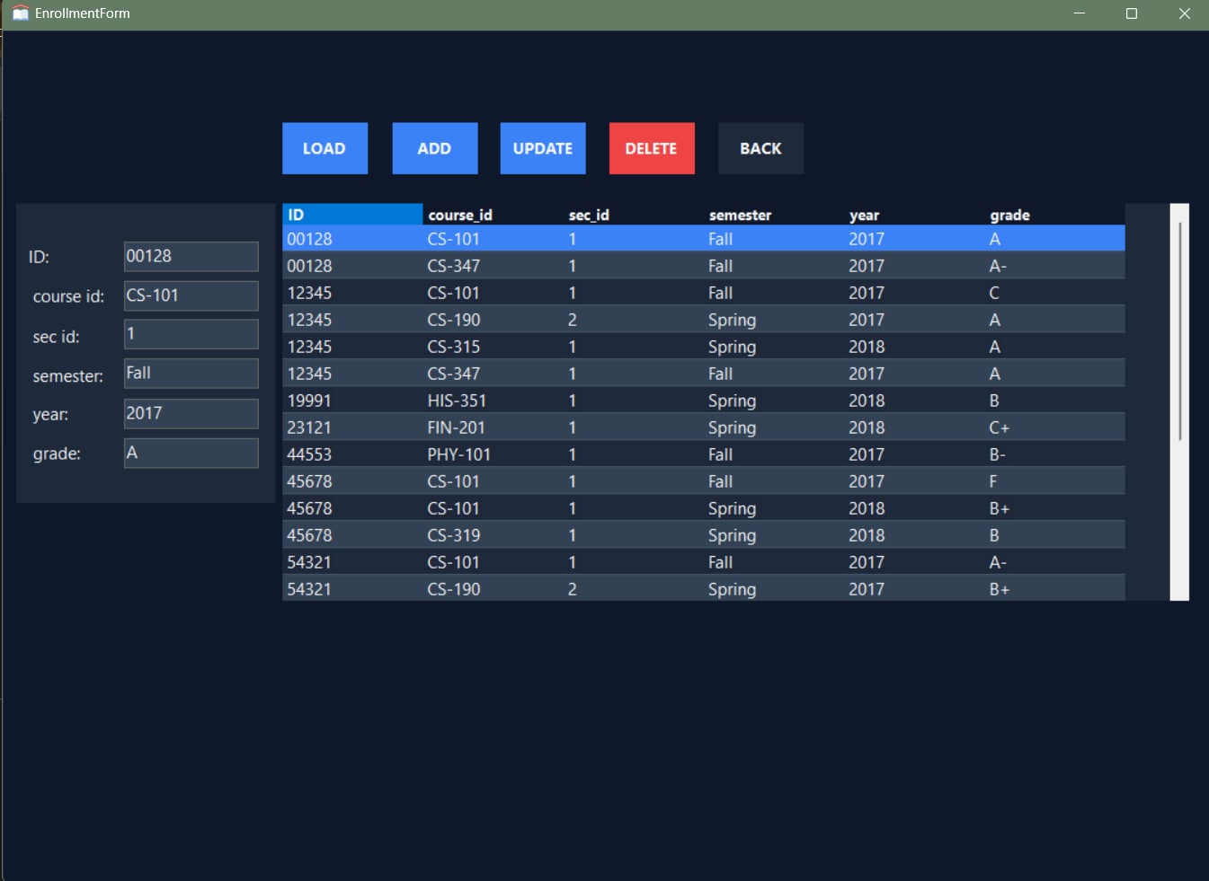
04 — CORE MODULES
Enrollment Tracking
The 'take' table is the heart of the system — it connects a student to a course section, semester, year, and final grade.
Each row records one student in one course section for one semester.
Grades feed directly into total-credit calculations on the Student module.
The same student can appear many times — once per course taken across terms.
This table is what makes department-level analytics possible in the Reports module.
Enrollment Form — student, course, section, semester, grade
11

Slide 12
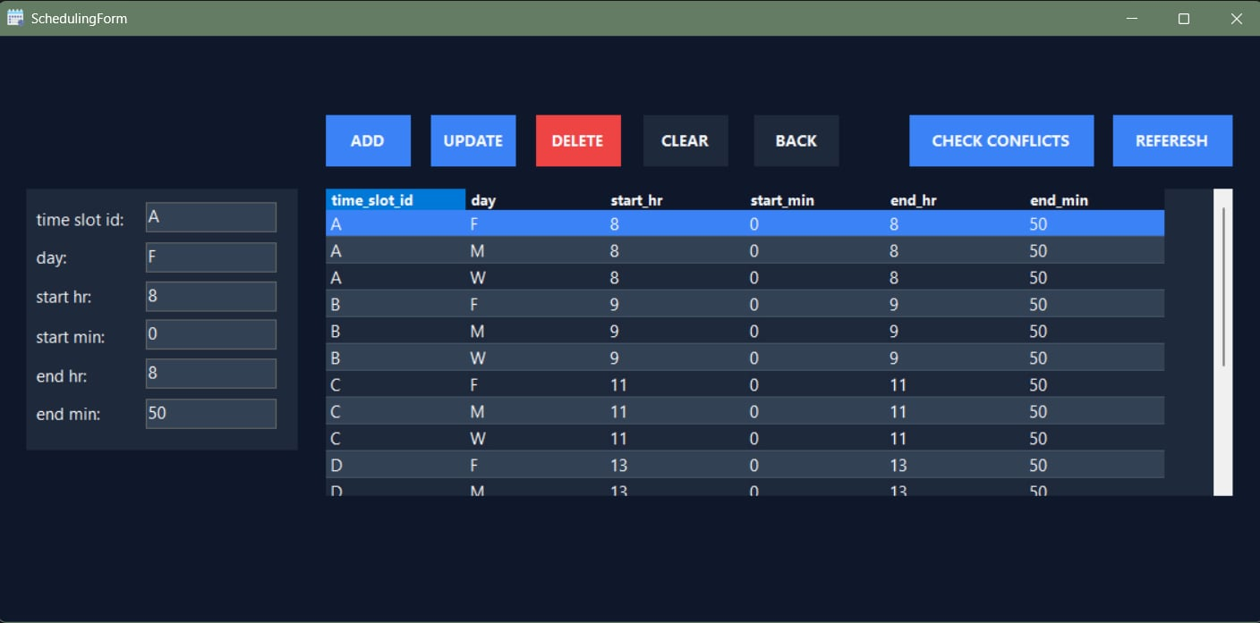


04 — CORE MODULES
Scheduling & Conflict Detection
Time slots define when a class meets. The built-in conflict checker flags overlapping bookings before they cause problems.
Day & Time Fields
Each slot has a day plus start/end hour and minute.
Overlap Detection
Check Conflicts scans same-day slots for overlapping ranges.
Validation Built In
Rejects invalid hours, minutes, or end-before-start entries.
Scheduling Form — time slots by day, with Check Conflicts
12

Slide 13
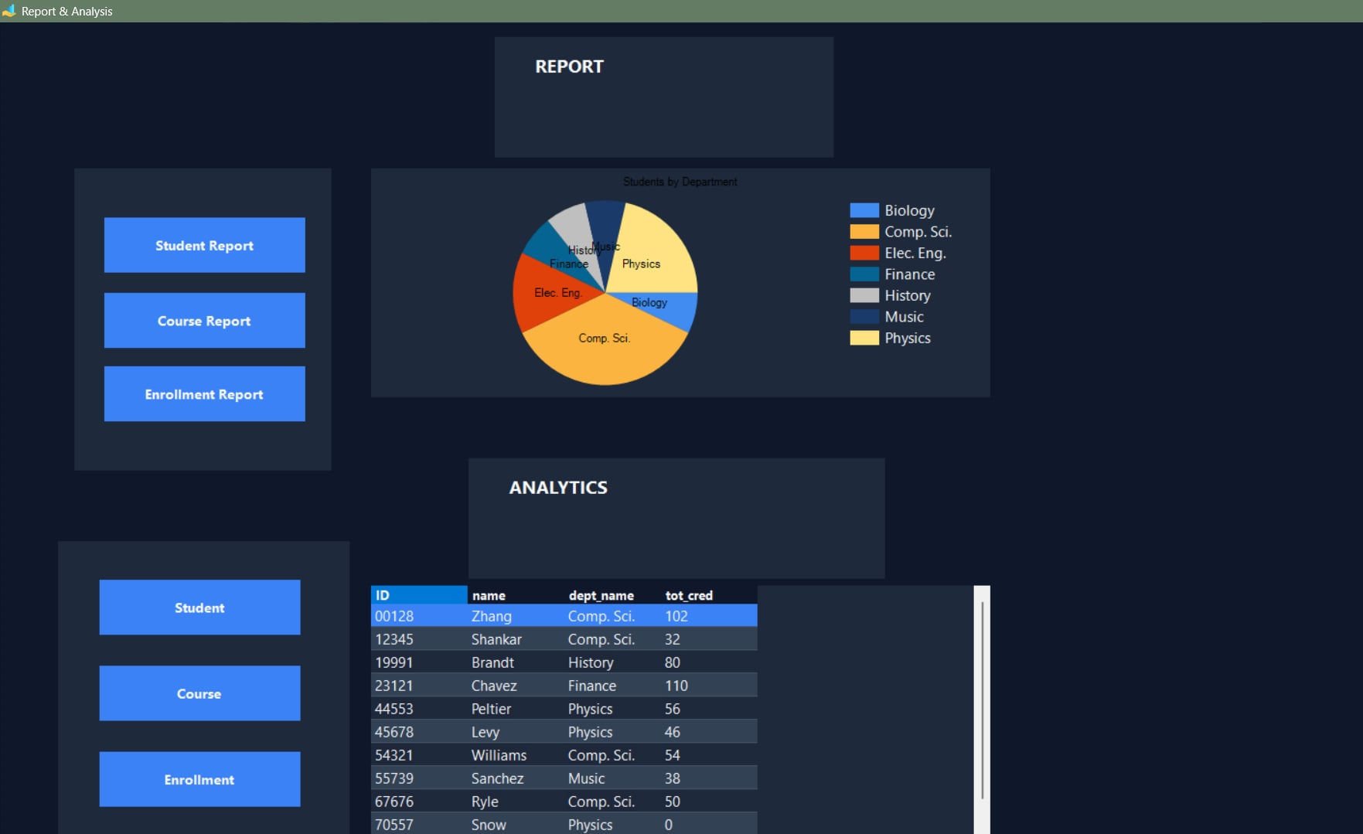

05 — REPORTING
Reports & Analytics
One screen turns raw tables into answers: student lists, course catalogs, grade joins, and a department breakdown chart.
Student / Course Reports
One-click pulls of the full student or course tables.
Enrollment + Grade Join
Combines student, course, and grade data in one view.
Students-by-Department Chart
Live pie chart built straight from a grouped SQL query.
Report & Analysis — pie chart of students by department, plus data grid
13

Slide 14
06 — ROADMAP
Where It Stands Today
An honest look at what the system already does well, and where it currently has room to grow.
Strengths
Current Limitations
• Single connected database removes duplicate spreadsheets
• Desktop-only (Windows WinForms) — no web or mobile access yet
• Role-based login keeps data access appropriate per user
• Single-user local SQL Express connection, not multi-campus ready
• Built-in schedule conflict checking
• Passwords stored without hashing in the current build
• One-click visual reports for department insight
• No automated email/SMS notifications for schedule changes
14

Slide 15



06 — ROADMAP
What's Next
Four steps to take the system from a working prototype to a production-ready campus platform.
1
2
3
4
Secure Authentication
Move to a Hosted Database
Web or Mobile Companion
Automated Notifications
Hash and salt passwords; add account lockout after failed attempts.
Migrate from local SQL Express to a centrally hosted SQL Server for multi-device access.
A lightweight student/instructor portal alongside the admin desktop app.
Email or SMS alerts for grade postings and schedule changes.
15

Slide 16
THANK YOU
Questions & Discussion
University Management System 2026 — built on C# WinForms, Entity Framework, and SQL Server.

